Slide 1
COMPONENT & DEPLOYMENT DIAGRAMS

Slide 2
COMPONENT in UML 2.0
Modular unit with well-defined interfaces that is replaceable within its environment
Autonomous unit within a system
Has one or more provided and required interfaces
Its internals are hidden and inaccessible
A component is encapsulated
Its dependencies are designed such that it can be treated as independently as possible

Slide 3
CASE STUDY
Development of an application collecting students’ opinions about courses
A student can
Read
Insert
Update
Make data permanent about the courses in its schedule
A professor can only see statistic elaboration of the data
The student application must be installed in pc client (sw1, sw2)
The manager application must be installed in pc client (in the manager’s office)
There is one or more servers with DataBase and components for courses management

Slide 4


COMPONENT NOTATION
A component is shown as a rectangle with
A keyword <<component>>
Optionally, in the right hand corner a component icon can be displayed
A component icon is a rectangle with two smaller rectangles jutting out from the left-hand side
This symbol is a visual stereotype
The component name
Components can be labelled with a stereotype
there are a number of standard stereotypes ex: <<entity>>, <<subsystem>>

Slide 5
Component ELEMENTS
A component can have
Interfaces
An interface represents a declaration of a set of
operations and obligations
Usage dependencies
A usage dependency is relationship which one element
requires another element for its full implementation
Ports
Port represents an interaction point between a component
and its environment
Connectors
Connect two components
Connect the external contract of a component to the internal structure

Slide 6
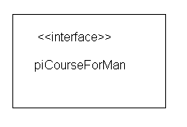
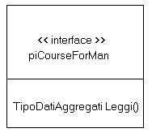
INTERFACE
May be shown using a rectangle symbol with a keyword <<interface>> preceding the name
For displaying the full signature, the interface rectangle can be expanded to show details
Can be
Provided
Required

Slide 7
INTERFACE
A component defines its behaviour in terms of provided and required interfaces
An interface
Is the definition of a collection of one or more operations
Provides only the operations but not the implementation
Implementation is normally provided by a class/ component
In complex systems, the physical implementation is provided by a group of classes rather than a single class

Slide 8


INTERFACE
A provided interface
Characterize services that the component offers to its environment
Is modeled using a ball, labelled with the name, attached by a solid line to the component
A required interface
Characterize services that the component expects from its environment
Is modeled using a socket, labelled with the name, attached by a solid line to the component
In UML 1.x were modeled using a dashed arrow

Slide 9


INTERFACE
Where two components/classes provide and require the same interface, these two notations may be combined
The ball-and-socket notation hint at that interface in question serves to mediate interactions between the two components
If an interface is shown using the rectangle symbol, we can use an alternative notation, using dependency arrows

Slide 10
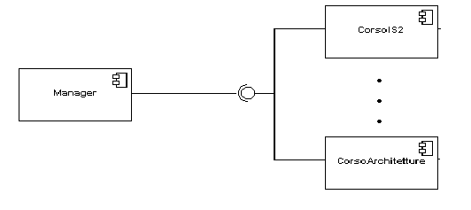
INTERFACE
In a system context where there are multiple components that require or provide a particular interface, a notation abstraction can be used that combines by joining
the interfaces
A component
Specifies a CONTRACT of the services that it provides to its clients and that it requires from others components in terms of its provided and required interfaces
Can be replaced
The system can be extended

Slide 11

DEPENDENCIES
Components can be connected by usage dependencies
Usage Dependency
A usage dependency is relationship which one element requires another element for its full implementation
Is a dependency in which the client requires the presence of the supplier
Is shown as dashed arrow with a <<use>> keyword
The arrowhead point from the dependent component to the one of which it is dependent

Slide 12
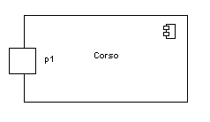
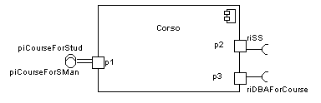
PORT
Specifies a distinct interaction point
Between that component and its environment
Between that component and its internal parts
Is shown as a small square symbol
Ports can be named, and the name is placed near the square symbol
Is associated with the interfaces that specify the nature of the interactions that may occur over a port

Slide 13

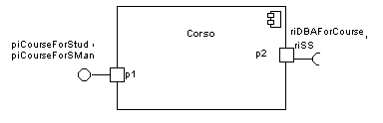
PORT
Ports can support unidirectional communication or bi-directional communication
If there are multiple interfaces associated with a port, these interfaces may be listed with the interface icon, separated by a commas

Slide 14
PORT
All interactions of a component with its environment are achieved through a port
The internals are fully isolated from the environment
This allows such a component to be used in any context that satisfies the constraints specified by its ports
Ports are not defined in UML 1.x

Slide 15

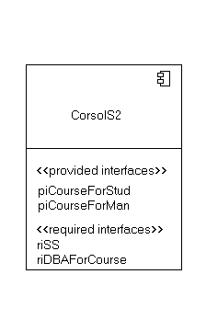
EXTERNAL VIEW
A component have an external view and an internal view
An external view (or black box view) shows publicly visible properties and operations
An external view of a component is by means of interface symbols sticking out of the component box
The interface can be listed in the compartment of a component box

Slide 16
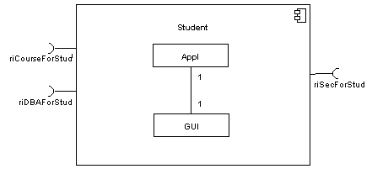
INTERNAL VIEW
An internal, or white box view of a component is where the realizing classes/components are nested within the component shape
Realization is a relationship between two set of model elements
One represents a specification
The other represent an implementation of the latter

Slide 17
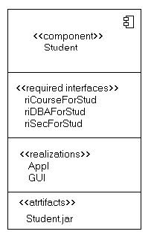
INTERNAL VIEW
The internal class that realize the behavior of a component may be displayed in an additional compartment
Compartments can also be used to display parts, connectors or implementation artifacts
An artifact is the specification of a phisycal piece of information

Slide 18
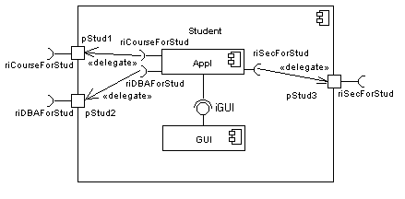
INTERNAL VIEW
Components can be built recursively

Slide 19

ASSEMBLY
Two kinds of connectors:
Delegation
Assembly
ASSEMBLY CONNECTOR
A connector between 2 components defines that one component provides the services that another component requires
He must only be defined from a required interface to a provided interface
An assembly connector is notated by a “ball-and-socket” connection
This notation allows for succint grafical
wiring of components

Slide 20
SEMANTICS
The semantics for an assembly connector :
Are that signals travel along an instance of a connector originating in a required port and delivered to a provided port
The interfaces provided and required must be compatible
The interface compatibility between provided and required ports that are connected enables an existing component in a system to be replaced

Slide 21
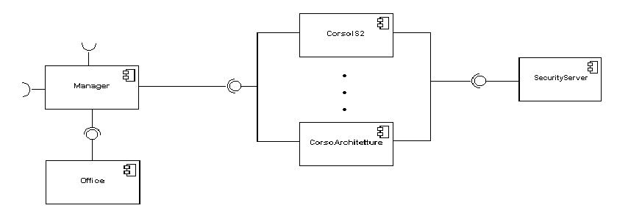
SEMANTICS
Multiple connections directed from a single required interface to provided interfaces indicates that the instance that will handle the signal will be determined at execution time

Slide 22
DELEGATION
DELEGATION CONNECTOR
Links the external contract of a component to the internal realization
Represents the forwarding of signals
He must only be defined between used interfaces or ports of the same kind

Slide 23
DELEGATION
The target interface must support a signature compatible with a subset of operations of the source interface
A port may delegate to a set of ports on subordinate components
The union of the target interfaces must be signature compatible with the source interface
Semantics:
Is a declaration that behaviour that is available on a component instance is not realized by that component itself, but by another instance that has compatible capabilities
Is used to model the hierarchical decomposition
Message and signal flow will occur between the connected ports

Slide 24
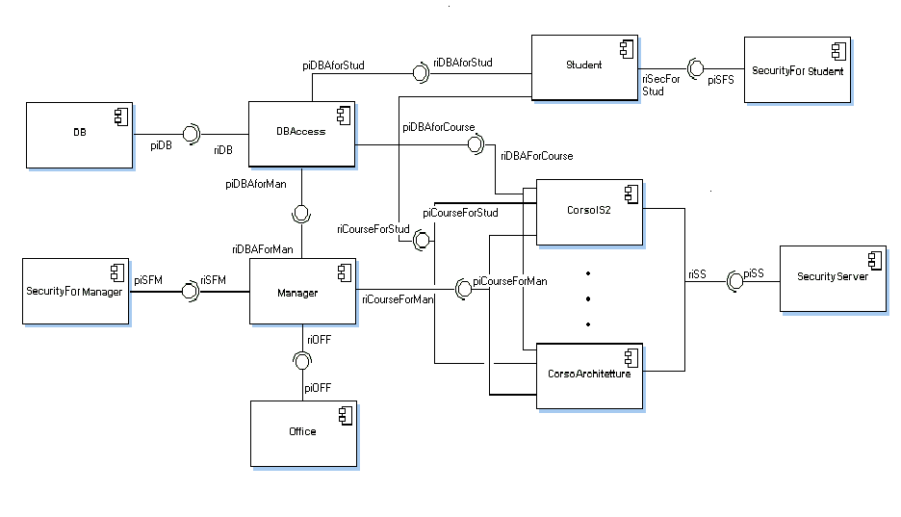
CASE STUDY

Slide 25
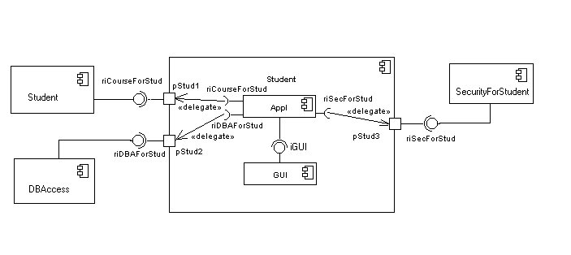
CASE STUDY

Slide 26
DEPLOYMENT DIAGRAMS
There is a strong link between components diagrams and deployment diagrams
Deployment diagrams
Show the physical relationship between hardware and software in a system
Hardware elements:
Computers (clients, servers)
Embedded processors
Devices (sensors, peripherals)
Are used to show the nodes where software components reside in the run-time system

Slide 27
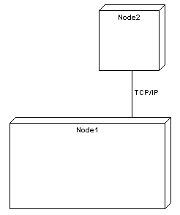
DEPLOYMENT DIAGRAMS
Deployment diagram
Contains nodes and connections
A node usually represent a piece of hardware in the system
A connection depicts the communication path used by the hardware to communicate
Usually indicates the method such as TCP/IP

Slide 28
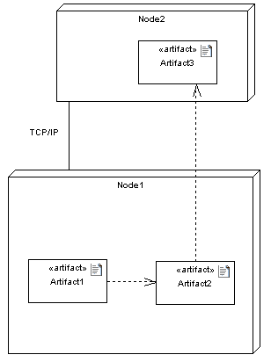
DEPLOYMENT DIAGRAMS
Deployment diagrams contain artifact
An artifact
Is the specification of a phisycal piece of information
Ex: source files, binary executable files, table in a database system,….
An artifact defined by the user represents a concrete element in the physical world

Slide 29
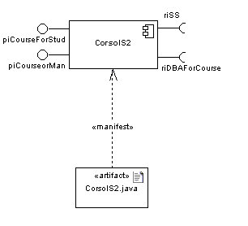
DEPLOYMENT DIAGRAMS
An artifact manifest one or more model elements
A <<manifestation>> is the concrete physical of one or more model elements by an artifact
This model element often is a component
A manifestation is notated as a dashed line with an open arrow-head labeled with the keyword <<manifest>>

Slide 30
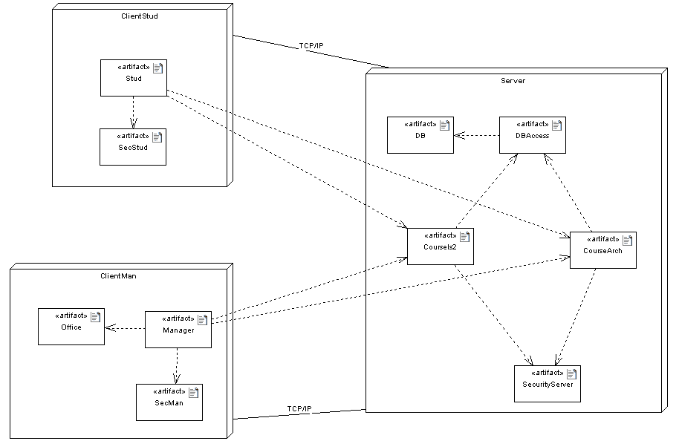
DEPLOYMENT DIAGRAMS

